Slide 1

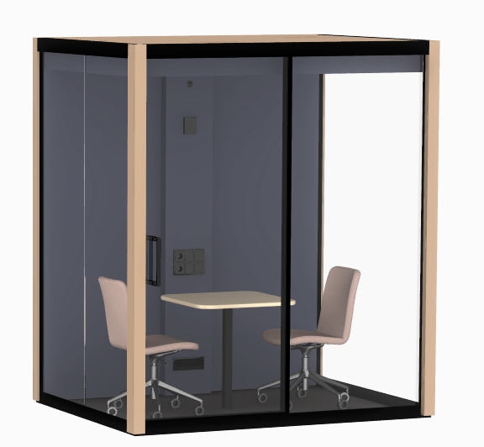
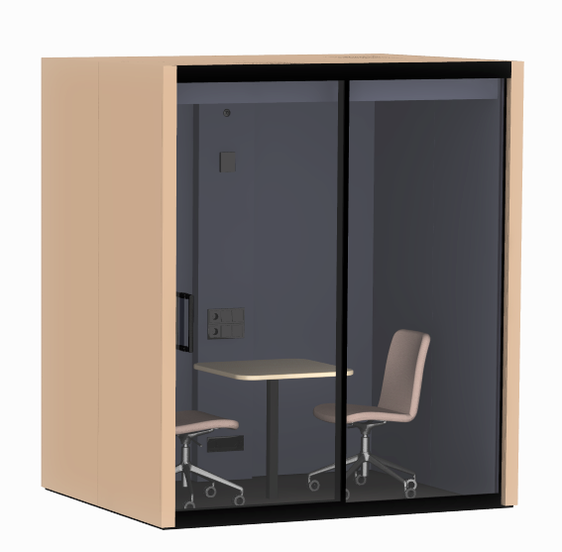
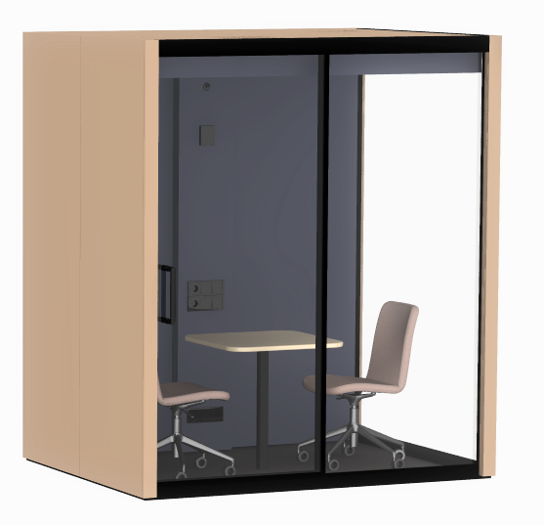
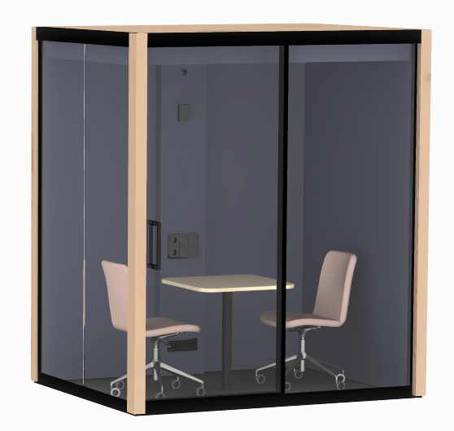
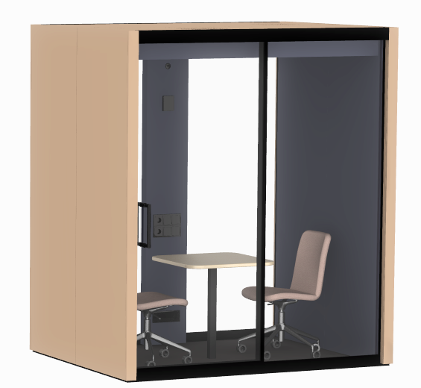

Vetrospace
Datasheet
Structure, accessories & materials
VETROSPACE Accessories:
Lamp dimmer
Electromagnetic locking
Control unit RFID
Door opening button
Interior sliding door
AV ready for the wall
AV readiness for electrical
Air conditioner with remote control
Sprinkler
Standard range of our 9 pods are 1m2 to 12m2 but with customization possibilities up to even 100m2.
Structural option number defines the locations of solid and glass walls. By changing this, you can populate each and every corner, hallway and other space of the room with perfectly matching pod.
Wide and space efficient dual panel sliding door can be placed anywhere on the glass wall.
Structure 1
Structure2
Structure 3
Structure 4
Structure 5

Slide 2
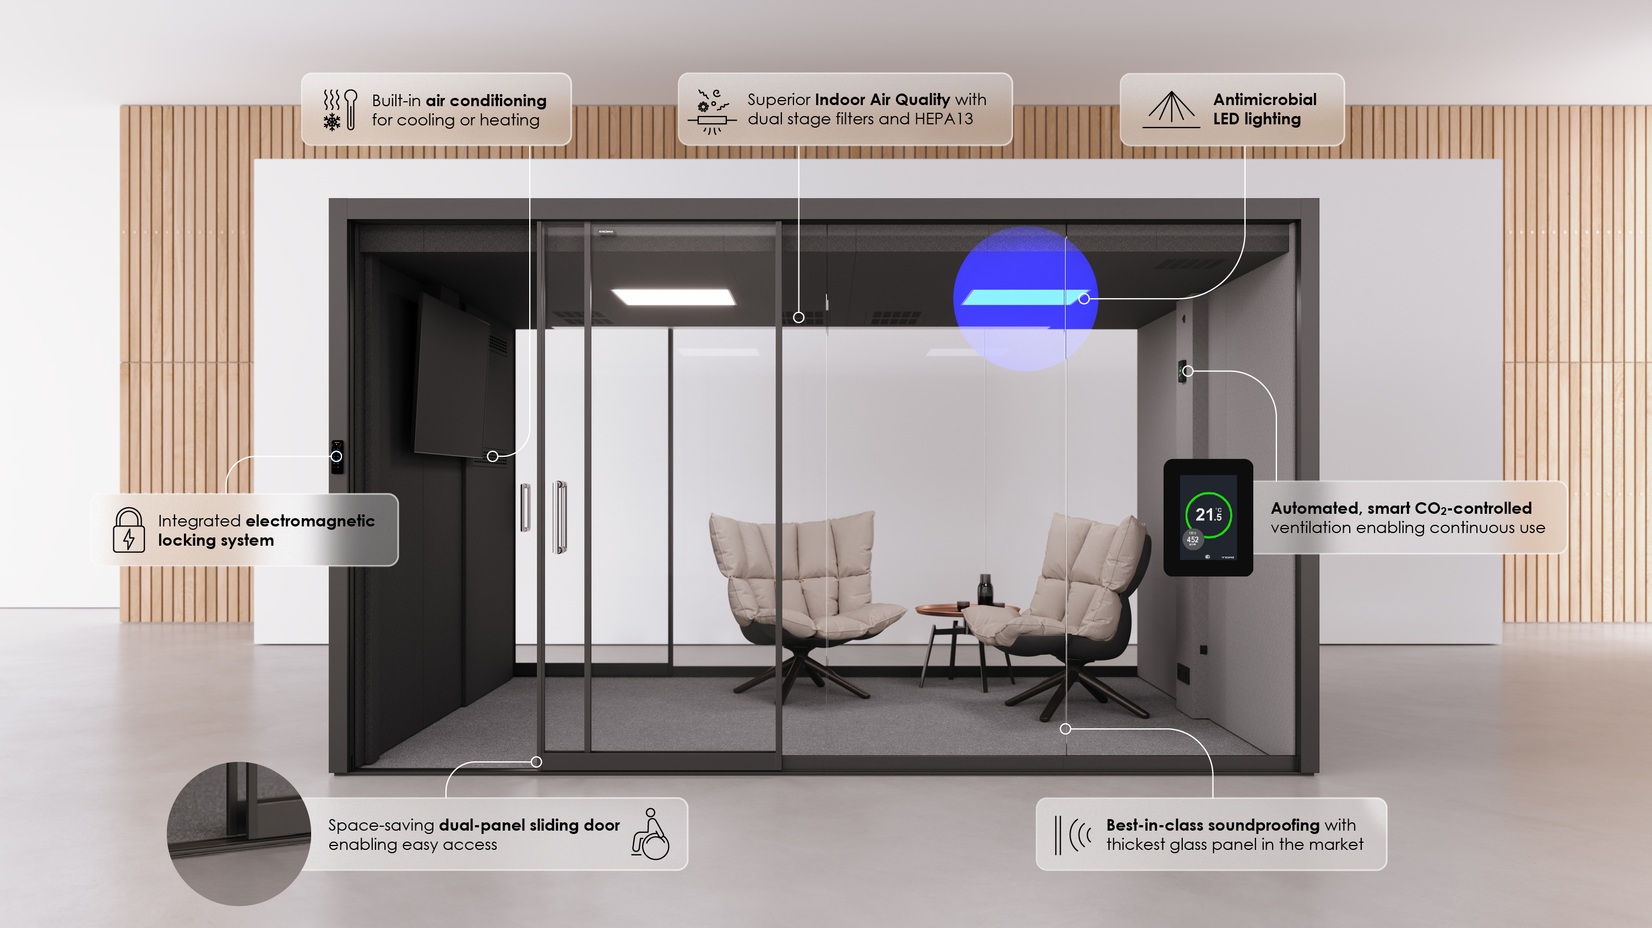

Slide 3
