Slide 1
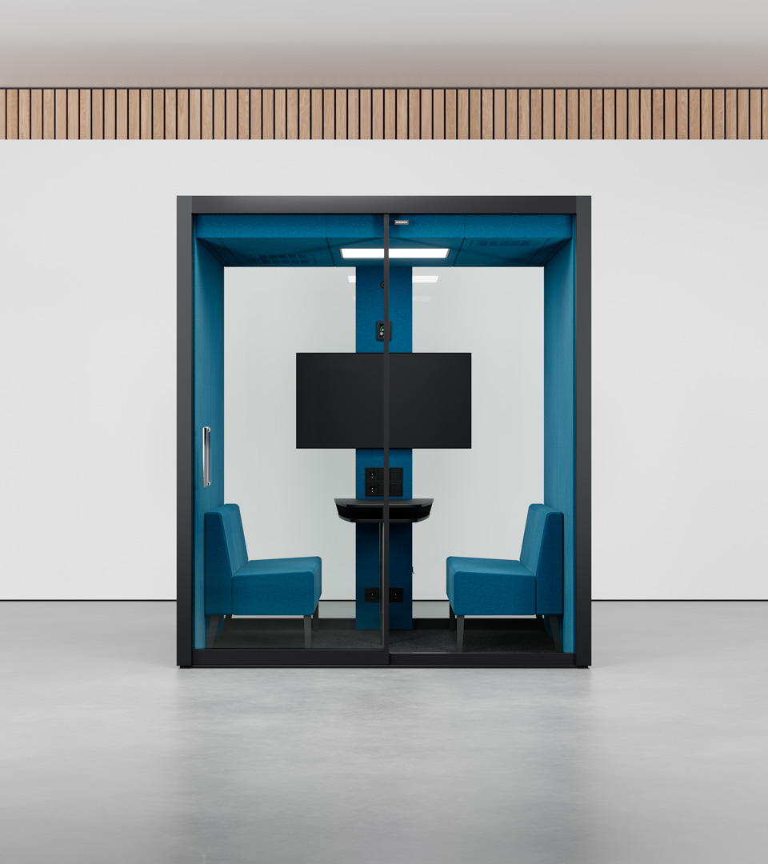

Vetrospace M+
Pod ideal for 1-4 people
A VETROSPACE IS MORE THAN JUST A POD – IT’S A PRODUCTIVE, PRIVATE, AND SAFE SPACE FOR WORKING, MEETING, AND COLLABORATING.
If you’re looking for a medium-sized individual workspace or a four-person meeting room, the M+ is the perfect solution. Just like our larger pods, our uniqueness comes from our sound reduction of +30dB, our two-stage air filtration (G4 prefilter + HEPA-13), our automatic CO2-controlled ventilation and photon disinfection LED lightning.
Exterior material is LP-laminate and 16,7 mm sound-controlled safety glass. Laminates in 6 standard colors, plus options for custom colors.
Interior is acoustic ECOfelt lining, with 5 standard colors and >50 additional colors.
Width
Depth
Height
Weight
210 cm
210 cm
240 cm
1050 kg

Slide 2


Vetrospace M+
TECHNICAL SPECS | M+
Exterior dimensions | W210 / D210 / H240 cm|W82.7 / D88.7 / H94.5 in
Exterior material | LP-laminate
Interior dimensions | W200 / D200 / H220 cm | W78.7 / D78.7 / H86.6 in
Interior material | Acoustic ECOfelt lining
Weight | 1050 kg | 2310 lbs
Indoor surface area | 4 m² | 43 ft²
Installation height recquirement | >250 cm | >98.5 in
Fire safety | UL 723: Class A-C (surface) ASTM E648:Class 1 (flooring)
Electrical safety | IEC 60335-1:2020 | UL 962 (E514776)
Seismic safety | Special SEISMIC Certification (2019-0176-COC-01-00) International Building Code (IBC) 2018 (23.02.2021) California Building Code (CBC) 2019 (23.02.2021)
Door | Patented sliding door
Glass thickness | 16.7 mm | 0.66 in sound-control safety glass
Sound reduction | Dₛ,A 30-31,5dB (ISO 23351-1), Rw 43-46dB, STI: 0.03
Ventilation system | Advanced two-stage air filtration (coarse and HEPA 13)
Air flow | Min 10 l/s, typical 60 l/s* and max 165 (max fan capacity)
Pressure | Positive air pressure
Lighting | VLD antimicrobial LED
Power supply | 110-240 VAC / 16 A / 50-60 Hz
Power | 70 W average, 300 W maximum
Power sockets | 4 as standard
Pod ideal for 4 people
Datasheet
If you’re looking for a medium-sized individual workspace or a 4 person meeting room, the VETROSPACE M+ pod is the perfect solution. Just like our larger pods, its superb soundproofing and efficient ventilation make for a highly productive environment.
Structural option number defines the locations of solid and glass walls. By changing this, you can populate each and every corner, hallway and other space of the room with perfectly matching pod.
Wide and space efficient dual panel sliding door can be placed anywhere on the glass wall.
VETROSPACE Optional accessories:
Lamp dimmer
Electromagnetic locking
Control unit RFID
Door opening button
Additional Interior sliding door
AV ready for the wall
AV readiness for electrical
Air conditioner with remote control
Automatic fire extinguisher system
* The pod is equipped with smart CO2 based ventilation control, typical
value is based on average occupancy & CO2 exhaled by users and will
vary based on measured value real time.​

Slide 3
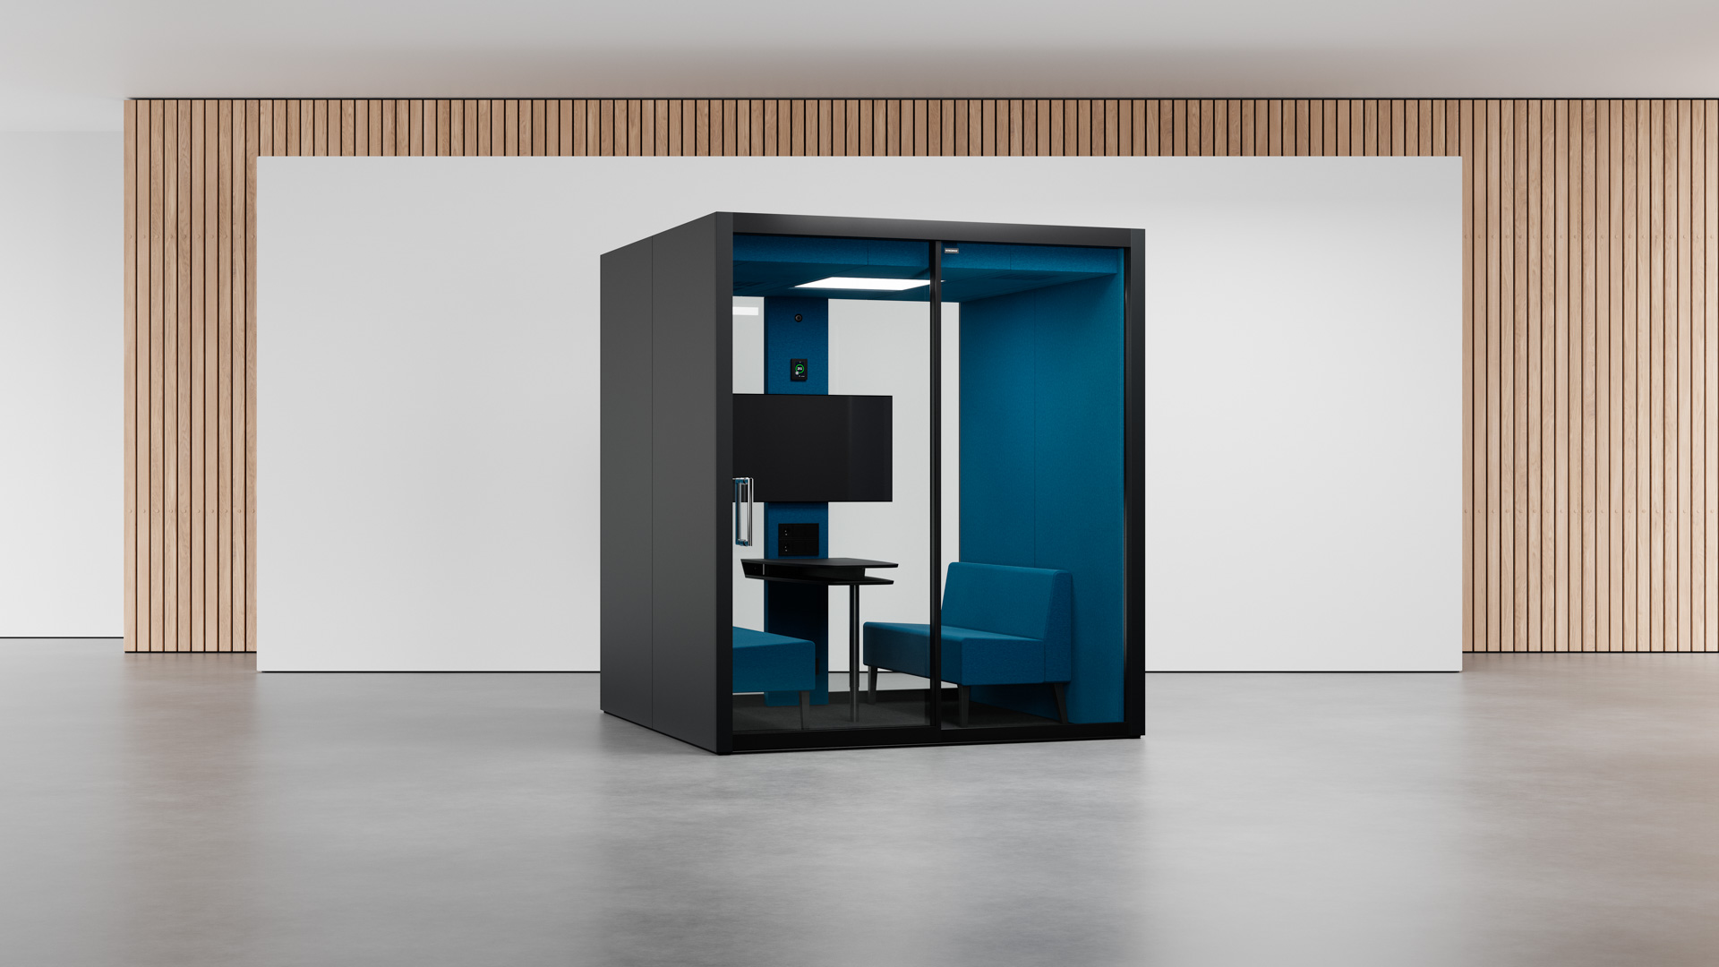
Vetrospace M+

Slide 4
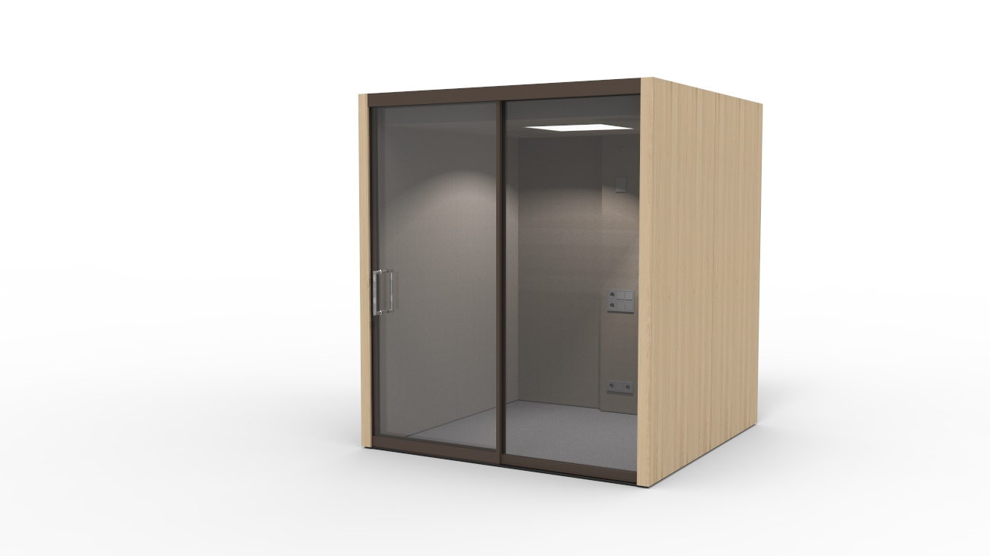
Vetrospace M+

Slide 5
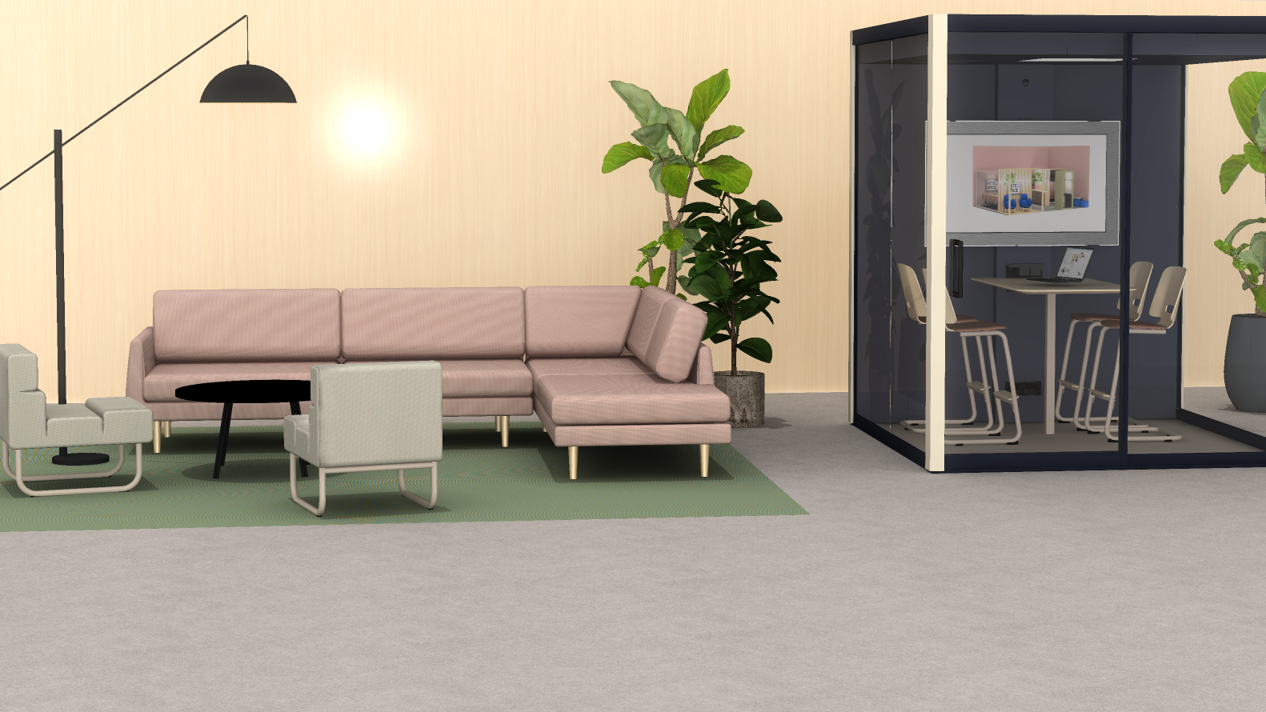
Vetrospace M+

