Slide 1
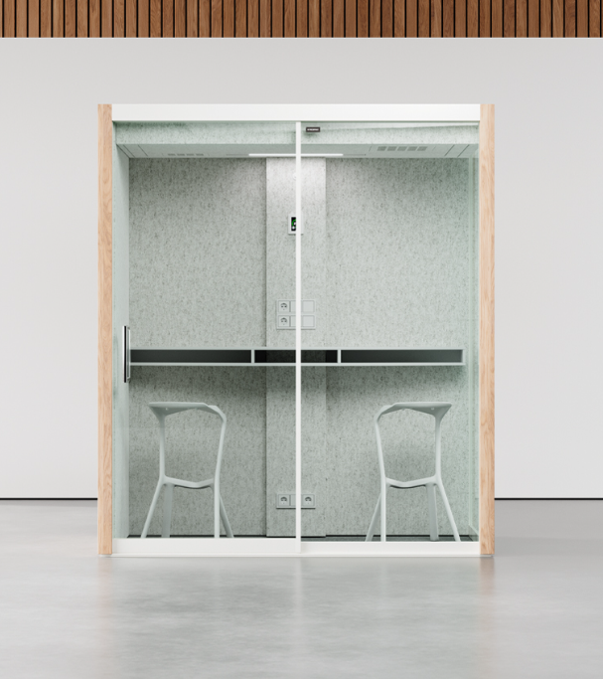

Vetrospace S/S+
Pod ideal for 1-2 people
A VETROSPACE IS MORE THAN JUST A POD – IT’S A PRODUCTIVE, PRIVATE, AND SAFE SPACE FOR WORKING, MEETING, AND COLLABORATING.
This compact 2 person meeting pod doubles as a personal space pod for video conferences, phone calls, or private corridor discussions. You can design and furnish it according to your needs from a variety of options.
Exterior material is LP-laminate and 16,7 mm sound-controlled safety glass. Laminates in 6 standard colors, plus options for custom colors.
Interior is acoustic ECOfelt lining, with 5 standard colors and >50 additional colors.
S
S+
Width
Depth
Height
Weight
210 cm
110 cm
240 cm
760 kg
210 cm
130 cm
240 cm
795 kg

Slide 2


Vetrospace S/S+
TECHNICAL SPECS | S & S+
Exterior dimensions | S: W210 / D110 / H240 cm, S+: W210 / D130 / H240
Exterior material | LP-laminate
Interior dimensions | S: W200 / D100 / H220 cm, S+: W200 / D120 / H220
Interior material | Acoustic ECOfelt lining
Weight | S 760kg | S+ 795kg
Indoor surface area | S 2m² | S+ 2.4m²
Installation height recquirement | >250 cm | >98.5 in
Fire safety | UL 723: Class A-C (surface) ASTM E648:Class 1 (flooring)
Electrical safety | IEC 60335-1:2020 | UL 962 (E514776)
Seismic safety | Special SEISMIC Certification (2019-0176-COC-01-00) International Building Code (IBC) 2018 (23.02.2021) California Building Code (CBC) 2019 (23.02.2021)
Door | Patented sliding door
Glass thickness | 16.7 mm | 0.66 in sound-control safety glass
Sound reduction | STI: 0,03 – Ds: 30,6dB (Can. 43-46dB Rw Lab.) (ISO 23351-1)
Ventilation system | Advanced two-stage air filtering (coarse and HEPA)
Air ventilation | Max 40l/s
Pressure | Positive air pressure
Lighting | VLD antimicrobial LED
Power supply | 110-240 VAC / 16 A / 50-60 Hz
Power | 50W average, 150W maximum
Power sockets | 4 as standard
Pod ideal for 1-2 people
Datasheet
This compact 2 person meeting pod doubles as a personal space pod for video conferences, phone calls, or private corridor discussions. You can design and furnish it according to your needs from a variety of options.
Structural option number defines the locations of solid and glass walls. By changing this, you can populate each and every corner, hallway and other space of the room with perfectly matching pod.
Wide and space efficient dual panel sliding door can be placed anywhere on the glass wall.
VETROSPACE Optional accessories:
Lamp dimmer
Electromagnetic locking
Control unit RFID
Door opening button
Additional Interior sliding door
AV ready for the wall
AV readiness for electrical
Air conditioner with remote control
Automatic fire extinguisher system
* The pod is equipped with smart CO2 based ventilation control, typical
value is based on average occupancy & CO2 exhaled by users and will
vary based on measured value real time.​

Slide 3
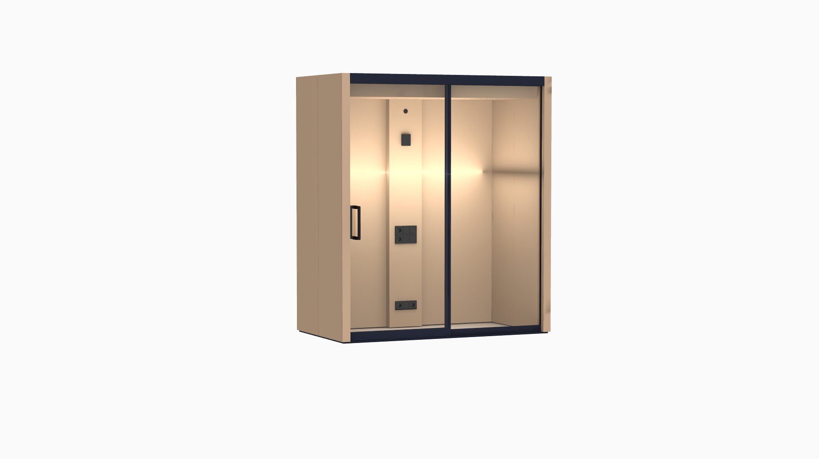
Vetrospace S

