Slide 1
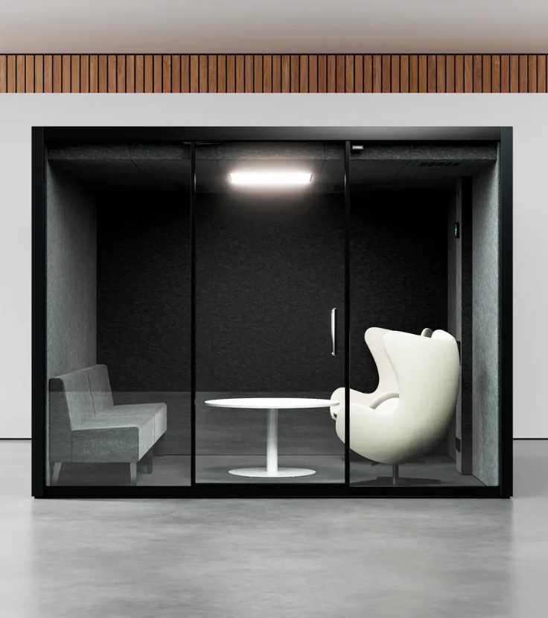
Vetrospace XL
Pod for up to 8 people
A VETROSPACE IS MORE THAN JUST A POD – IT’S A PRODUCTIVE, PRIVATE, AND SAFE SPACE FOR WORKING, MEETING, AND COLLABORATING.
Enjoy exceptional sound insulation and air quality in our second-largest pod, which offers plenty of space for up to eight and also works as a cozy private space. You can design and furnish it according to your needs from a variety of options.
Exterior material is LP-laminate and 16,7 mm sound-controlled safety glass. Laminates in 6 standard colors, plus options for custom colors.
Interior is acoustic ECOfelt lining, with 5 standard colors and >50 additional colors.
Width
Depth
Height
Weight
310 cm
310 cm
240 cm
1600 kg

Slide 2
Vetrospace XL
TECHNICAL SPECS | XL
Exterior dimensions | W310 / D310 / H240 cm
Exterior material | LP-laminate
Interior dimensions | W300 / D300 / H220 cm
Interior material | Acoustic ECOfelt lining
Weight | 1600 kg | 3520 lbs
Indoor surface area | 12 m² | 129.1 ft²
Installation height recquirement | >250 cm | >98.5 in
Fire safety | UL 723: Class A-C (surface) ASTM E648:Class 1 (flooring)
Electrical safety | IEC 60335-1:2020 | UL 962 (E514776)
Seismic safety | Special SEISMIC Certification (2019-0176-COC-01-00) International Building Code (IBC) 2018 (23.02.2021) California Building Code (CBC) 2019 (23.02.2021)
Door | Patented sliding door
Glass thickness | 16.7 mm | 0.66 in sound-control safety glass
Sound reduction | Dₛ,A 30-31,5dB (ISO 23351-1), Rw 43-46dB, STI: 0.03
Ventilation system | Advanced two-stage air filtering-coarse and HEPA
Air flow | Max 120l/s
Pressure | Positive air pressure
Lighting | VLD antimicrobial LED lighting
Power supply | 110-240 VAC / 16 A / 50-60 Hz
Power | 100 W average, 550 W maximum
Power sockets | 4 as standard
Pod for up to 8 people
Datasheet
Enjoy exceptional sound insulation and air quality in our second-largest pod, which offers plenty of space for up to eight and also works as a cozy private space. You can design and furnish it according to your needs from a variety of options.
Structural option number defines the locations of solid and glass walls. By changing this, you can populate each and every corner, hallway and other space of the room with perfectly matching pod.
Wide and space efficient dual panel sliding door can be placed anywhere on the glass wall.
VETROSPACE Optional accessories:
Lamp dimmer
Electromagnetic locking
Control unit RFID
Door opening button
Additional Interior sliding door
AV ready for the wall
AV readiness for electrical
Air conditioner with remote control
Automatic fire extinguisher system
* The pod is equipped with smart CO2 based ventilation control, typical
value is based on average occupancy & CO2 exhaled by users and will
vary based on measured value real time.​

Slide 3
Vetrospace XL

Slide 4
Vetrospace XL

