Slide 1
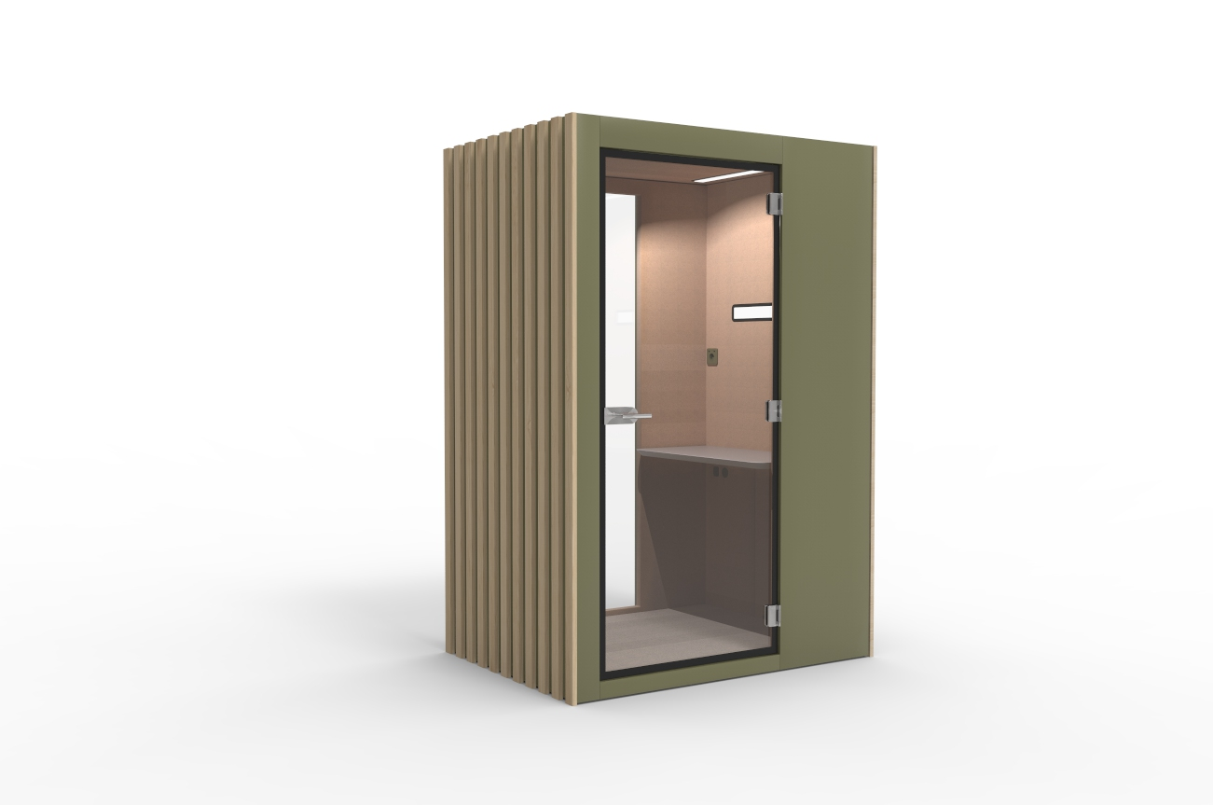
Vetrospace XS+
Pod for 1
A VETROSPACE IS MORE THAN JUST A POD – IT’S A PRODUCTIVE, PRIVATE, AND SAFE SPACE FOR WORKING, MEETING, AND COLLABORATING.
XS+ Hybrid is a new pod type focusing on hybrid working. It is planned for longer periods of focused work or for longer duration teleconferencing and webcasting. You have enough of space for a comfortable chair and a table that is large enough for notebooks, laptop etc. It has optionality between fixed and electrically adjustable table and the separately dimmable ambient and facial lights gives you a natural look for every meeting.
XS+ is optimized against audio and visual snooping, has a motion sensor for smart control of lighting and air flow.
Exterior material is LP-laminate and 11 mm sound-controlled safety glass. Laminates in 6 standard colors, plus options for custom colors.
Interior is acoustic ECOfelt lining, with 5 standard colors and >50 additional colors.
Width
Depth
Height
Weight
150 cm
110 cm
225 cm
550 kg

Slide 2
Vetrospace XS+
TECHNICAL SPECS | XS+
Exterior dimensions | W150 / D110 / H225 cm|W59.1 / D43.3 / H88.6 in
Exterior material | LP-laminate
Interior dimensions | W130 / D100 / H207.5 cm | W51.2 / D39.4 / H81.7 in
Interior material | Acoustic ECOfelt lining
Weight | 550 kg | 1210 lbs (TBC)
Indoor surface area | 1.4 m² | 15 ft²
Installation height recquirement | 235 cm | >92.5 in
Fire safety | UL 723: Class A-C (surface) ASTM E648:Class 1 (flooring)
Electrical safety | IEC 60335-1:2020 | UL 962 (E514776)
Seismic safety | Special SEISMIC Certification (2019-0176-COC-01-00) International Building Code (IBC) 2018 (23.02.2021) California Building Code (CBC) 2019 (23.02.2021)
Door | Hinged door
Glass thickness | 11 mm | 0.43 in sound-control safety glass
Sound reduction | Dₛ,A 30dB (ISO 23351-1), STI: 0.05
Ventilation system | Basic single state coarse (G4) air filtering
Air flow | Min 10 l/s, typical 20 l/s* and max 58 (max fan capacity)
Pressure | Positive air pressure
Power supply | 110-240 VAC / 16 A / 50-60 Hz
Power | 50 W average, 150 W maximum (TBC)
Power sockets | 1 as standard
Pod for 1
Datasheet
XS+ comes with two structure options, meaning you can choose to have glass on two walls (structure 5), or only the glass door (structure 2).
XS+ has retractable wheels underneath for ease of moving the pod within a floor of a building. The basic single state course (G4) air filtering, keeps the inner air fresh and clean, and in normal use to be changed only two times a year.
Plug-and-play solution
Best-in-class soundproofing
Antimicrobial LED lighting
Built-in wheels for easy relocation
Excellent ventilation for fresh air
* The pod is equipped with smart CO2 based ventilation control, typical
value is based on average occupancy & CO2 exhaled by users and will
vary based on measured value real time.​

Slide 3
Vetrospace XS+

